Slide 1

Regression
Teoh Teik Toe
ITOM/NBS
ttteoh@ntu.edu.sg
97905202

Slide 2
Reading before class
https://www.youtube.com/watch?v=zPG4NjIkCjc
https://www.youtube.com/watch?v=HjkR9KzhKN4
Drive:
Code: https://drive.google.com/drive/folders/1fXjR7HWQVDvW4b_UwFmEM_NymlOo4Wbw?usp=sharing
Data: https://drive.google.com/drive/folders/1DWSSkL9zMwXktar8rxC_3rUGqxwNNTrR?usp=sharing

Slide 3
Agenda
Regression Theory
What is regression and the metrics
Types of regression
Application & Interview Questions
Advantages & Disadvantages & Limitation
Programming of Regression
Examples
DBS (Regression)
Equity Financial Data (Classification)
Treynor (Regression)

Slide 4
Part I Regression Theory

Slide 5
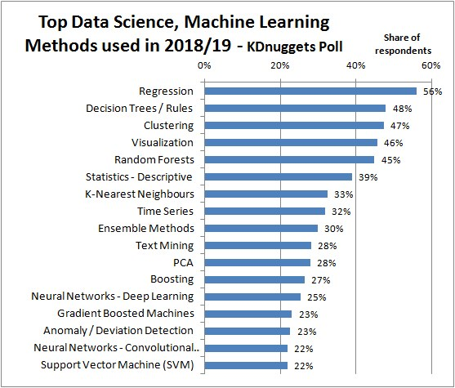
https://images.app.goo.gl/RZL5fApQc5t4syyr5

Slide 6
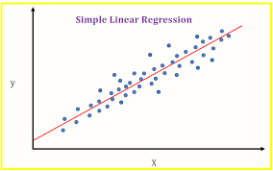
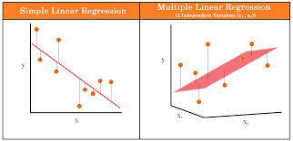
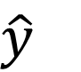
Linear Regression Model Line
Coefficient – Try and Error (Brute Force)
$y=b_{0}+{b_{1}x}_{1}+b_{2}x_{2}+…+b_{m}x_{m}+e$
$\hat{y}$
Must be normally distributed
Use QQ Plot test

Slide 7
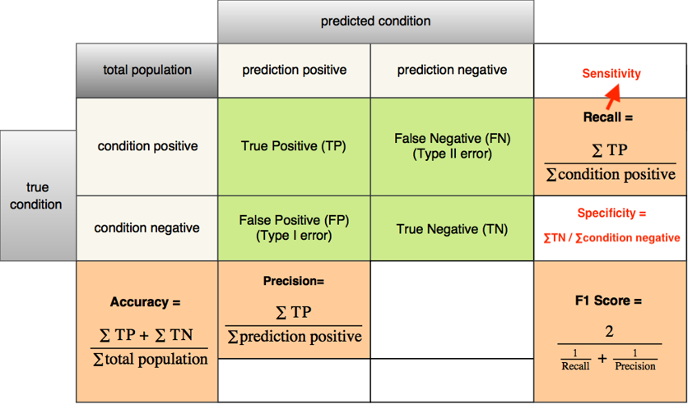
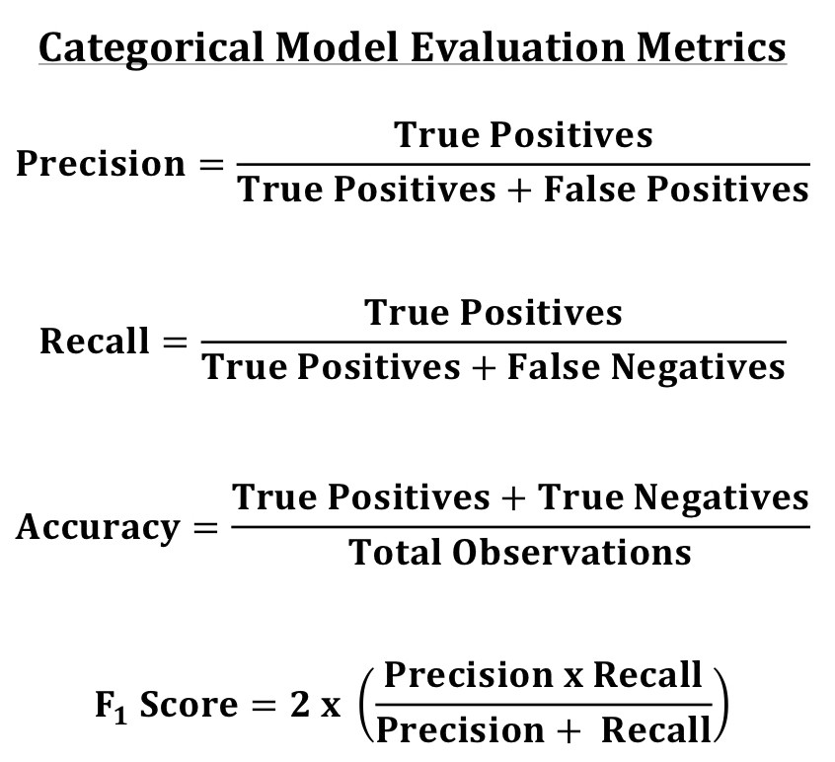
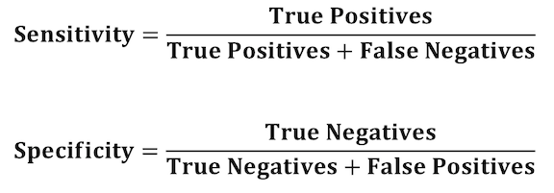
Categorical - Metrics

Slide 8
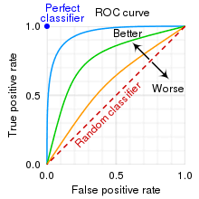
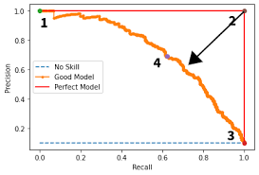
Metrics (Graph)
from sklearn.metrics import plot_roc_curve
plot_roc_curve(model,X_test,Y_test)
from sklearn.metrics import plot_precision_recall_curve
plot_precision_recall_curve(model,X_test,Y_test)
When you force the false negative to go down, the speed of increasing false positive?? VV

Slide 9

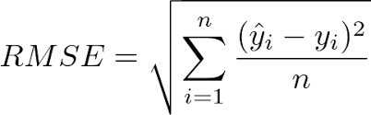
Continuous metrics - RMSE
5 types of error:
Error
Square Error
Sum of Square Error
Mean Square Error
Root Mean Square Error

Slide 10
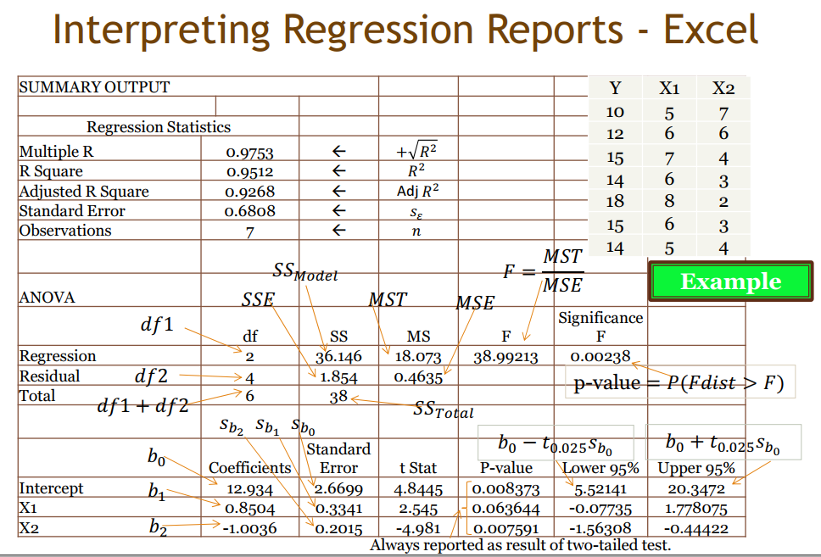
ANOVA Table
R test
F test t test

Slide 11
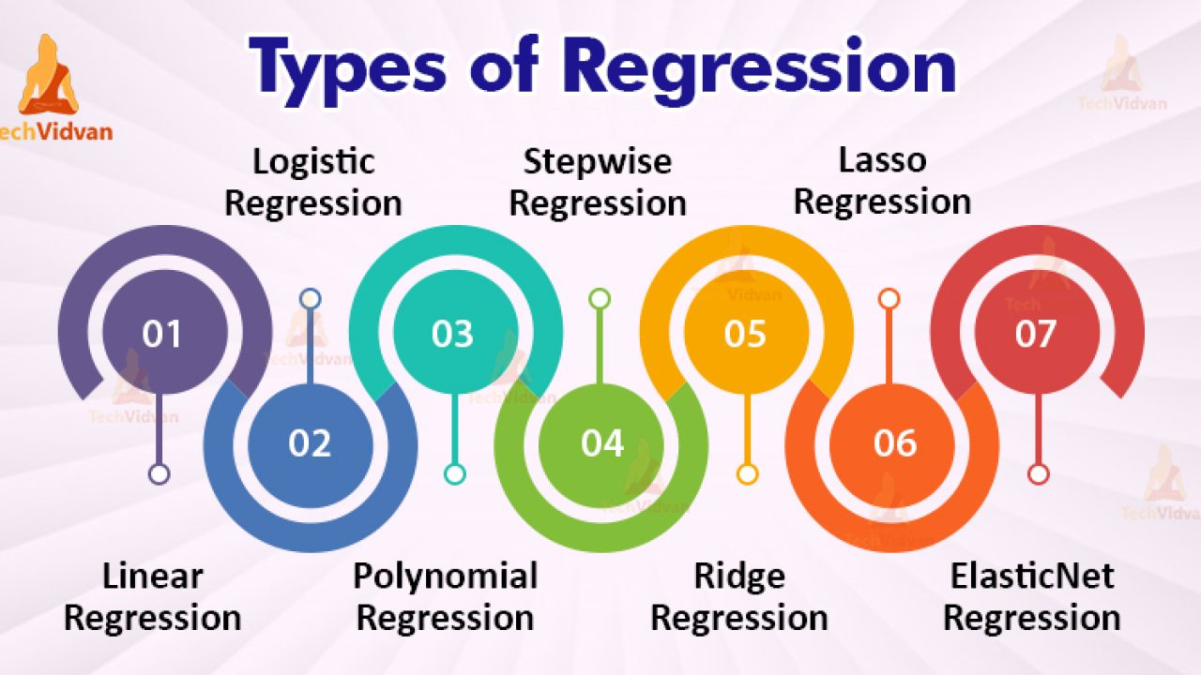
Types of Regression
https://www.youtube.com/watch?v=_3xMSbIde2I
https://www.youtube.com/watch?v=ctmNq7FgbvI

Slide 12
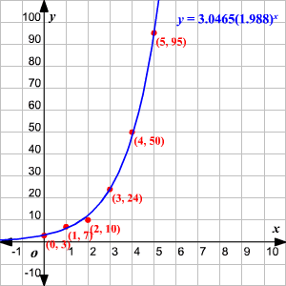

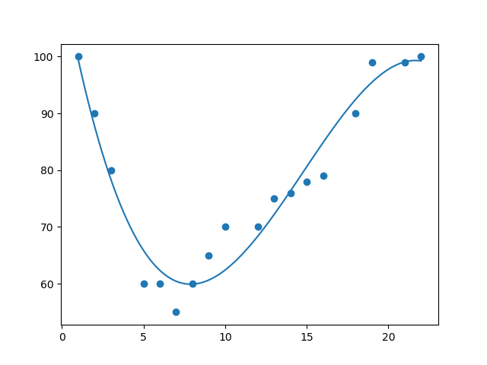
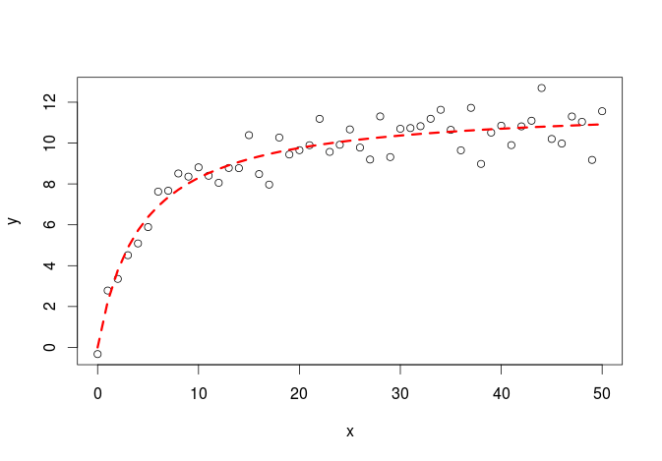
Shape of regression
Linear
Exponential
Polynomial
Logarithm

Slide 13
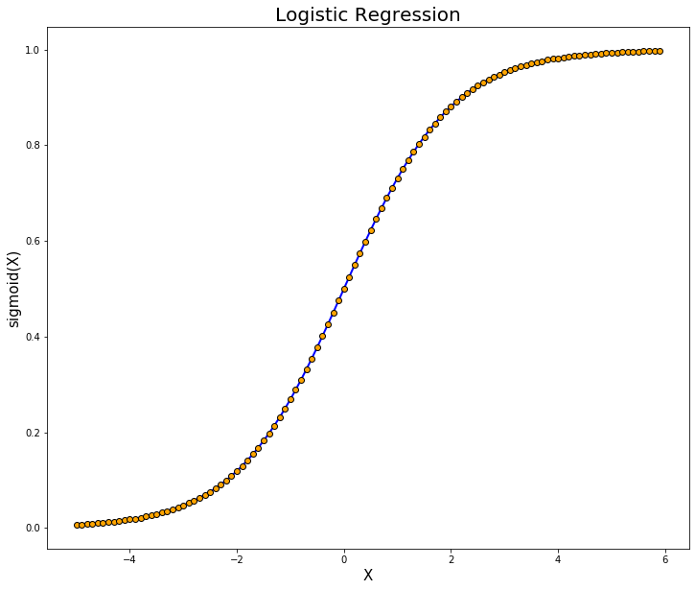
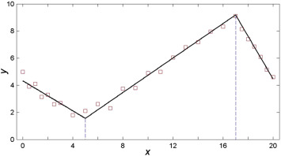
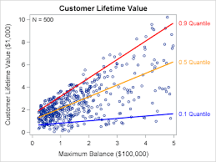
Shape of regression
Logistic
MARS (Adaptive)
Quantile

Slide 14
Application
Supervised Learning (historical labeled data available)
Trend Prediction like
Financial Prediction
Economic Prediction
Pattern Recognition (Business Insights)
Sales
Purchase
Voting Pattern

Slide 15
Regression Interview Questions (Can we answer all after this class)
What are the important assumptions of Linear regression?
What is heteroscedasticity?
What is the difference between R square and adjusted R square?
How to find RMSE and MSE?
What are the possible ways of improving the accuracy of a linear regression model?
How to interpret a Q-Q plot in a Linear regression model?
What is the significance of an F-test in a linear model?
What are the disadvantages of the linear model?
https://www.proschoolonline.com/blog/data-science-interview-questions-on-linear-regression

Slide 16
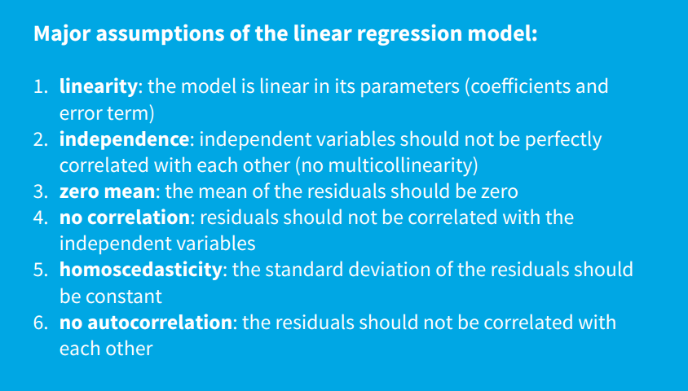
Limitation: Hilpisch Page 34

Slide 17

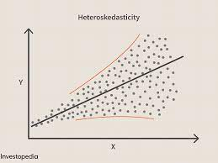
What is heteroscedasticity?
Heteroscedasticity is exactly the opposite of homoscedasticity, which means that the error terms are not equally distributed.

Slide 18
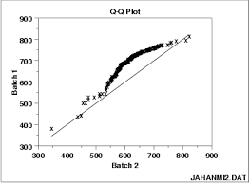
How to interpret a Q-Q plot in a Linear regression model?
A Q-Q plot is used to check the normality of errors. This shows that the errors are mostly normally distributed.

Slide 19
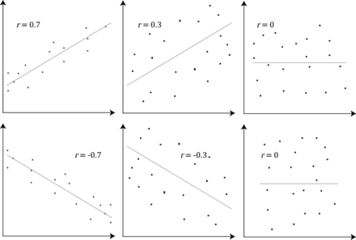
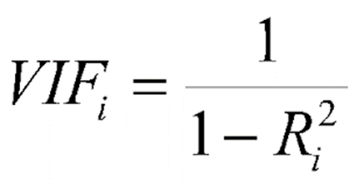
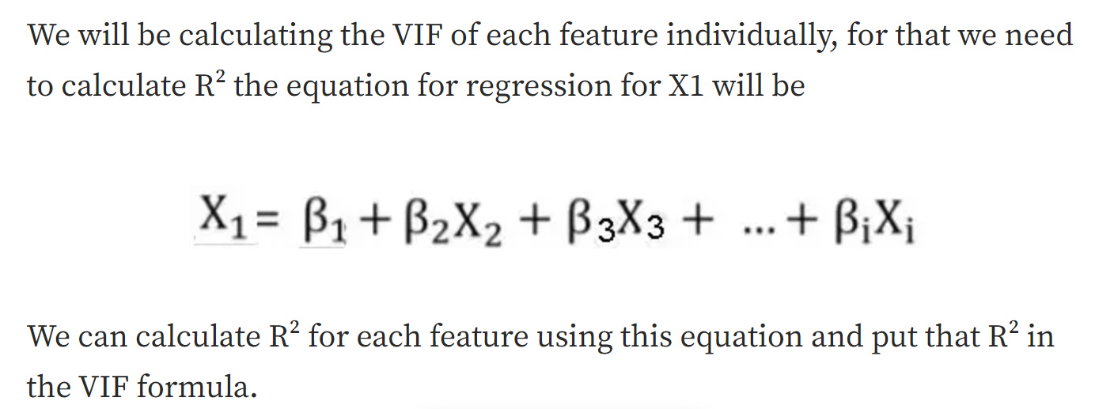
Multi-Collinearity – Check VIF

Slide 20
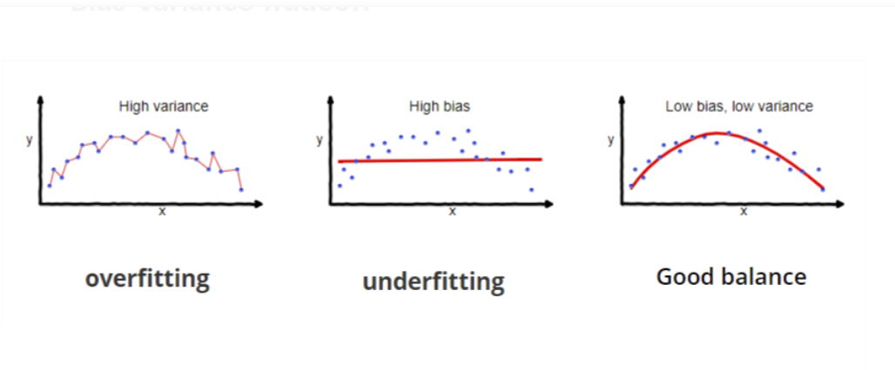
What are the disadvantages of the linear model?
Linear regression is sensitive to outliers which may affect the result.
Under-fitting

Slide 21
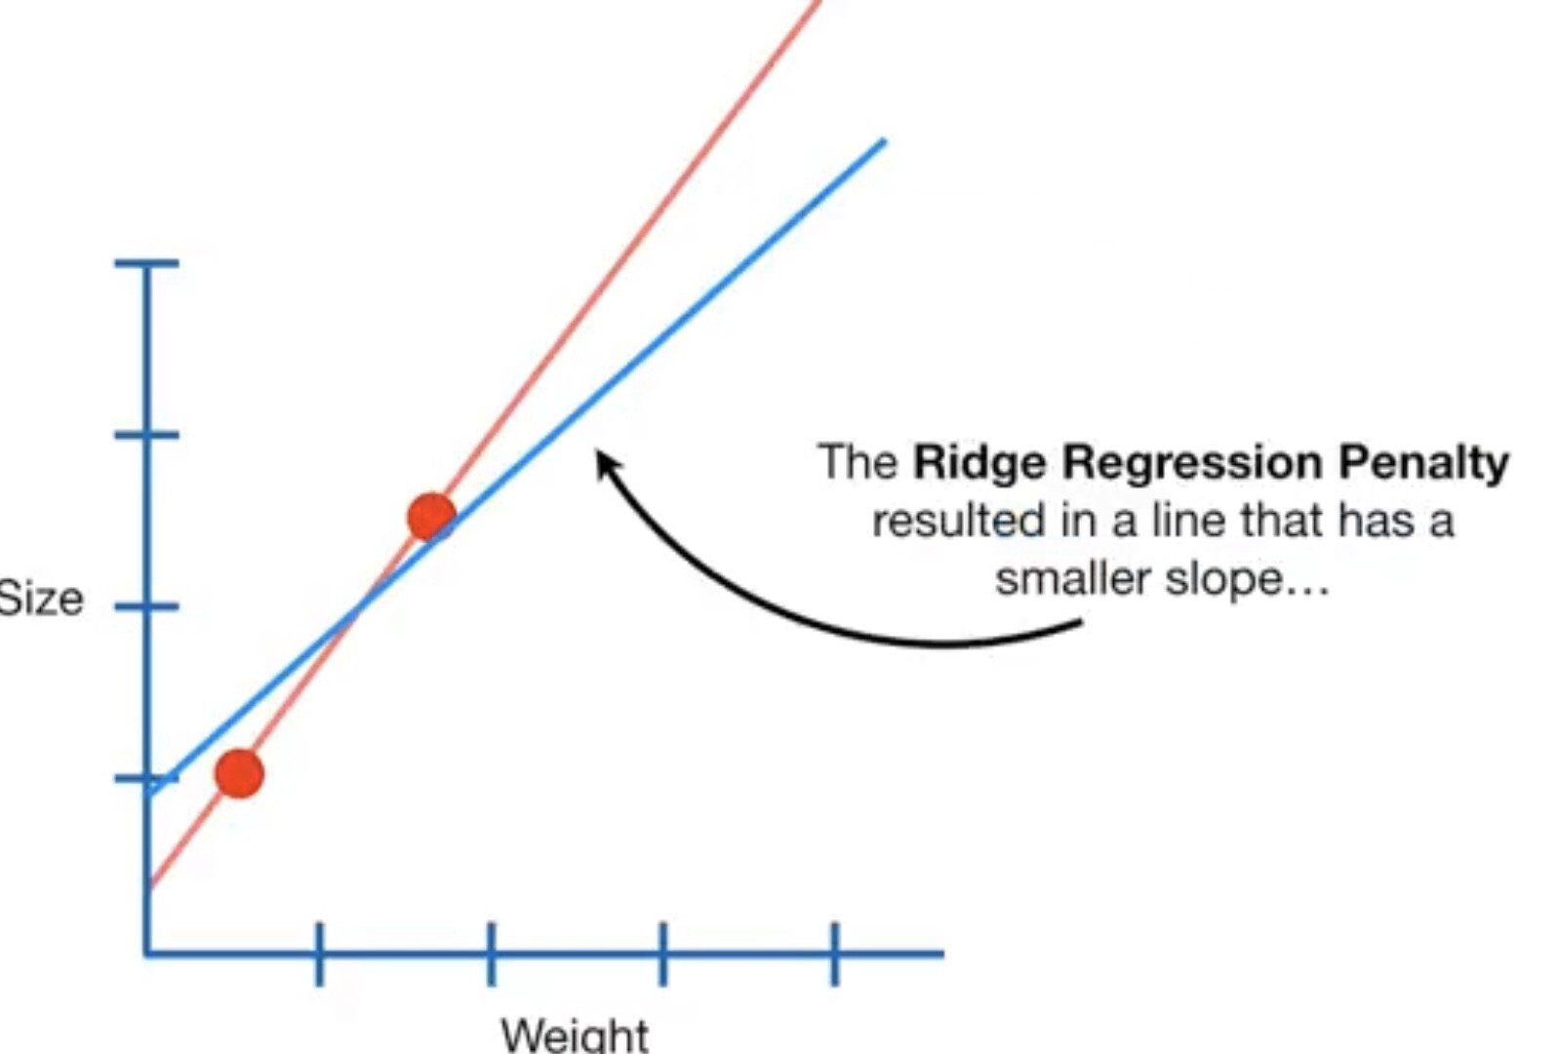
Others
Ridge (reduce the coefficients but NOT to absolute zero)
Lasso regression (make coefficients to absolute zero)
model= linear_model.Ridge()
model.fit(X, Y)
pred=model.predict(X)
print(mean_squared_error(pred, Y)**0.5)

Slide 22
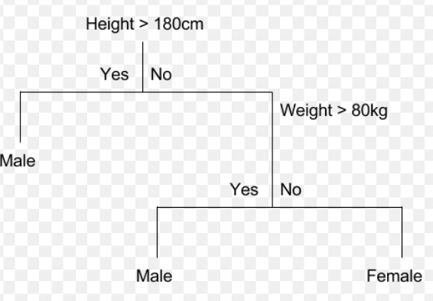
Comparison Regression, Decision Tree and Neural Network
$$y=b_{0}+{b_{1}x}_{1}+b_{2}x_{2}+…+b_{m}x_{m}+e$$
Parameter
Y: gender X1: Height X2: Weight
X1: Height
w.
Y: Gender
X2: Weight
.w

Slide 23
Part II Programming

Slide 24
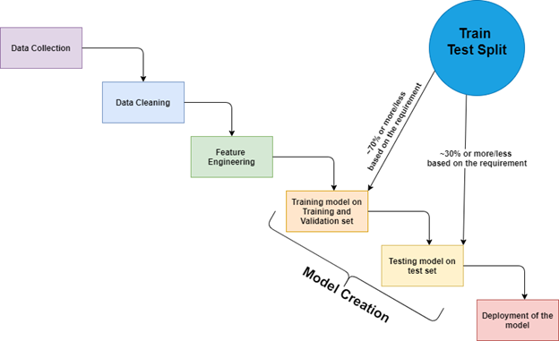
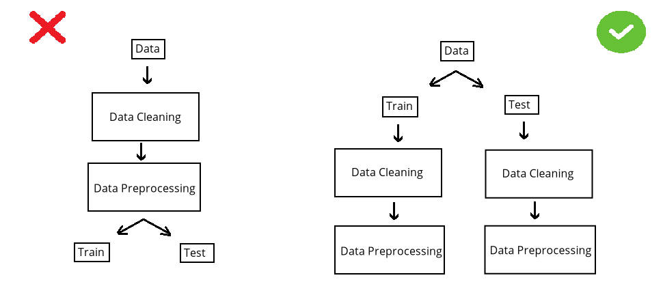

Slide 25
Machine Learning Process
Import data
Decide on Target/Y/Dependent Variable
Check null (imputation?) – May need to check correlation before check null
df.isnull().any() and df["Revenue"].isnull().sum()
If needed, pd.set_option("display.max_rows", 10)
If you have categorical and continuous X, need to do dummy first so that you can use for loop.
#imputation ??
df.isnull().sum()/len(df)
m = df["10Y Net Income Growth (per Share)"].mean()
df["10Y Net Income Growth (per Share)"].fillna(m,inplace=True)
#need to ensure all columns are number
for i in df.columns:
m = df[i].mean()
df[i].fillna(m,inplace=True)
#or using model
pip install miceforest
import miceforest as mf
k = mf.ImputationKernel(df,datasets=1,random_state=1)
k.mice(10) #10 interation
df = k.complete_data(0)
#for categorical
from sklearn.preprocessing import Imputer
imp = Imputer(strategy='most_frequent')
imp.fit(df)
Or
imp = Imputer(strategy=‘constant’,fill_value=“missing)

Slide 26
Machine Learning Process
4. Select features – if not many features, take all. If clean, use Kbest, else use correlation
Kbest – Need to split X,Y
X = df.drop(columns="Creditability")
Y = df["Creditability"]
from sklearn.feature_selection import SelectKBest, f_regression
f = SelectKBest(score_func=f_regression, k=10).fit(X,Y).get_support()
X.columns[f]
df = df.loc[:, ["Creditability", 'Account Balance', 'Duration of Credit Mths',
'Payment Status of Previous Credit', 'Credit Amount’]]
2. Correlaton
pd.set_option("max_rows", None)
c = df.corr()
c = abs(c["fund_treynor_ratio_5years"])
c[c>0.2].sort_values()
df["sector_technology"].isnull().sum() #check if selected columns many nulls
pd.set_option("max_rows", 10)
from sklearn.decomposition import PCA
pca = PCA(n_components=10)
X = pca.fit_transform(X)
Notes:
.

Slide 27
Machine Learning Process
#remove not a number
for i in df.columns:
df1 = pd.to_numeric(df[i], errors='coerce')
df=df[df1.notnull()] #make it to null then remove null
print(df)
Clean - Dropna() (rare situation need to remove non numeric)
Categorical input – Use Dummy variable – if too categories, drop the variable
dummy = pd.get_dummies(df["Sex and Marital Status"]) #optional, set prefix=“xxx”
df = df.merge(dummy, right_index=True, left_index=True)
df = df.drop(columns="Sex and Marital Status)
Data Visualization
df.describe() #check mean : too big then normalization, max or min too much difference, then remove (outlier)
df.boxplot(figsize=(40,10)) #check for outlier
df.hist(figsize=(20,20))
import seaborn as sns
sns.heatmap(df.corr())
sns.catplot(data=df,x="Account Balance",y="Creditability",kind="violin")
#kind=violin, bar, nothing means scatter
df["Sex and Marital Status"].value_counts()

Slide 28
Matplotlib.pyplot
#continuous vs continuous
from matplotlib import pyplot as plt
plt.scatter(df["Creditability"],df["Credit Amount"])
plt.title("Creditability vs Credit Amount")plt.xlabel("fund")
plt.xlabel("Relative")
plt.legend(["price_earnings_ratio", "price_book_ratio"])
plt.show()
#categorical vs continuous
plt.scatter(df["Class"], df["Dividend per Share"])
plt.scatter(df["Class"], df["10Y Net Income Growth (per Share)"])
plt.xlabel("fund")
plt.xlabel("Relative")
plt.title("Fund vs Relative")
plt.legend(["price_earnings_ratio", "price_book_ratio"])
plt.show()

Slide 29
Machine Learning Process
Split data – 2 types, need remove outlier or not
#remove outlier
from sklearn.model_selection import train_test_split df_train,df_test = train_test_split(df)
from scipy import stats
z = abs(stats.zscore(df_train))
df_train = df_train[(z<5).all(axis=1)]
#no outlier
from sklearn.model_selection import train_test_split
X = df.drop(columns="Class")
Y = df["Class"]
X_train,X_test,Y_train,Y_test = train_test_split(X,Y)
9. Check number of category of Y and imbalance, if imbalance, use SMOTE (if continuous Y, then no need)
df_train["class"].value_counts()
#if remove outlier - X_train = df_train.drop(columns="class"), Y_train = df_train["class"]
from imblearn.over_sampling import SMOTE
X_train, Y_train = SMOTE().fit_resample(X_train, Y_train)
10. Normalization do after splitting, need to do twice, one for train and one for test (use df.describe to check if normalization is needed)
#if remove outlier but no oversampling, X_test = df_test.drop(columns="class"), Y_test = df_test["class"]
for i in X_train.columns:
X_train[i] = stats.zscore(X_train[i])
for i in X_test.columns:
X_test[i] = stats.zscore(X_test[i])
for i in X_train.columns:​
X_train[i] = stats.zscore(X_train[i])

Slide 30
Machine Learning Process
Import model
Train on trainset
Test on testset (rmse if continuous Y and accuracy if categorical Y. If categorical, need to use confusion matrix to ensure no bias in prediction on one category)
Feature ranking (depends on model, random forest is good)
Save model using joblib
Optimization or Limitation (for Decision Tree is a must use grid, else overfitting, for Regression, need to check QQ, Anova, VIF)
Front End – HTML
Back End - Flask
Cloud (PythonAnywhere)
importances = list(zip(model.feature_importances_, x.columns))
importances.sort(reverse=True)
print(importances)

Slide 31
Classifier
from sklearn.metrics import confusion_matrix
from sklearn import linear_model
model = linear_model.LogisticRegression()
model.fit(X_train,Y_train)
pred = model.predict(X_test)
cm = confusion_matrix(Y_test,pred)
print("accuracy", (cm[0,0]+cm[1,1])/(sum(sum(cm))))
from sklearn import tree
model = tree.DecisionTreeClassifier()
model.fit(X_train,Y_train)
pred = model.predict(X_test)
cm = confusion_matrix(Y_test,pred)
print("accuracy", (cm[0,0]+cm[1,1])/(sum(sum(cm))))

Slide 32
Classifier
from sklearn import ensemble
model = ensemble.RandomForestClassifier()
model.fit(X_train,Y_train)
pred = model.predict(X_test)
cm = confusion_matrix(Y_test,pred)
print("accuracy", (cm[0,0]+cm[1,1])/(sum(sum(cm))))
from sklearn import ensemble
model = ensemble.GradientBoostingClassifier()
model.fit(X_train,Y_train)
pred = model.predict(X_test)
cm = confusion_matrix(Y_test,pred)
print("accuracy", (cm[0,0]+cm[1,1])/(sum(sum(cm))))
from sklearn import neural_network
model = neural_network.MLPClassifier(max_iter=500)
# model = neural_network.MLPRegressor(solver="lbfgs", hidden_layer_sizes=(12,2))
model.fit(X_train,Y_train)
pred = model.predict(X_test)
cm = confusion_matrix(Y_test,pred)
print("accuracy", (cm[0,0]+cm[1,1])/(sum(sum(cm))))

Slide 33
Regressor
from sklearn.metrics import mean_squared_error
from sklearn import linear_model
model = linear_model.LinearRegression()
model.fit(X_train, Y_train)
pred = model.predict(X_test)
print("rmse is : ", mean_squared_error(Y_test, pred))
from sklearn import tree
model = tree.DecisionTreeRegressor()
model.fit(X_train, Y_train)
pred = model.predict(X_test)
print("rmse is : ", mean_squared_error(Y_test, pred))

Slide 34
Regressor
from sklearn import ensemble
model = ensemble.RandomForestRegressor()
model.fit(X_train, Y_train)
pred = model.predict(X_test)
print("rmse is : ", mean_squared_error(Y_test, pred))
model = ensemble.GradientBoostingRegressor()
model.fit(X_train, Y_train)
pred = model.predict(X_test)
print("rmse is : ", mean_squared_error(Y_test, pred))
from sklearn import neural_network
model = neural_network.MLPRegressor(max_iter=500)
#model = neural_network.MLPRegressor(solver="lbfgs", hidden_layer_sizes=(12,2))
model.fit(X_train, Y_train)
pred = model.predict(X_test)
print("rmse is : ", mean_squared_error(Y_test, pred))

Slide 35
Save model and load model
# save the model to disk
Import joblib
joblib.dump(model, 'model name')
# load the model from disk and predict from existing to validate the load
model = joblib.load('model name’)
Print(model.predict([[data]]))

Slide 36
For Tree - Classifier Optimization
#using grid
from sklearn.model_selection import GridSearchCV
model = tree.DecisionTreeClassifier()
grid = GridSearchCV(estimator = model, param_grid = dict(max_depth = [i for i in range(1, 20)]),cv=10)
grid = grid.fit(X_train, Y_train)
grid.best_params_
grid.best_score_
#manual
X_train1, X_validate, Y_train1, Y_validate = train_test_split(X_train,Y_train)
for i in range(10):
print(i)
model = DecisionTreeClassifier(max_depth = i+1)
model.fit(X_train1, Y_train1)
pred = model.predict(X_validate)
cm = confusion_matrix(Y_validate, pred)
accuracy = (cm[0,0] + cm[1,1])/sum(sum(cm))
print(accuracy)

Slide 37
For Tree - Regressor Optimization
#manual
X_train1, X_validate, Y_train1, Y_validate = train_test_split(X_train,Y_train)
for i in range(20):
print(i)
model = DecisionTreeRegressor(max_depth= i+2)
model.fit(X_train1, Y_train1)
pred = model.predict(X_validate)
rmse = mean_squared_error(Y_validate, pred) ** 0.5
print(rmse)

Slide 38
For Regression - VIF
#vif to check collinearity
#1 = not correlated.
#Between 1 and 5 = moderately correlated.
#Greater than 5 = highly correlated.
from statsmodels.stats.outliers_influence import variance_inflation_factor
vif_data = pd.DataFrame()
vif_data["feature"] = X.columns
vif_data["VIF"] = [variance_inflation_factor(X.values, i) for i in range(len(X.columns))]
print(vif_data)

Slide 39
For Regression – QQ, Anova
QQ plot (check Heteroscedasticity)
import statsmodels.api as sm
from matplotlib import pyplot as plt
mod_fit = sm.OLS(Y,X).fit()
res = mod_fit.resid # residuals
fig = sm.qqplot(res)
plt.show()
Anova (check significant)
from statsmodels.formula.api import ols
from statsmodels.stats.anova import anova_lm
model = ols("Y ~ X", df).fit()
print(model.summary())
anova_results = anova_lm(model)
print('\nANOVA results')
print(anova_results)

Slide 40
Part III Examples

Slide 41
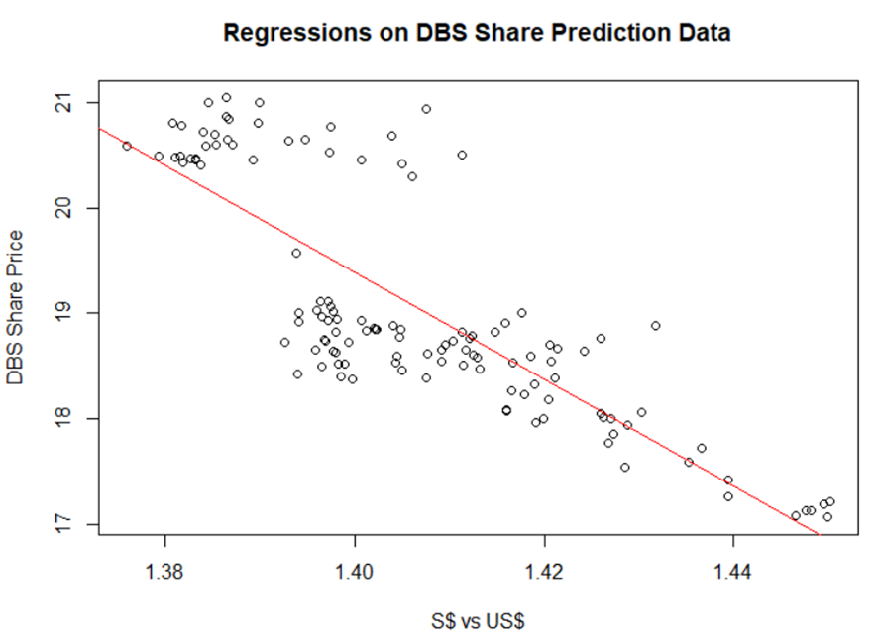
Linear Regression
Y has a linear relationship with the Xs.
Notes:
Error must be random

Slide 42
Data Analysis: When $S Strengthen, will DBS share price up or down?
When Sing Dollar strengthen, DBS share price will be expensive for foreign investor, therefore, DBS price should go down, if everything else remain the same.
However, when Sing Dollar strengthen, DBS asset in S$ will appreciate from foreign investor perspective, hence, if DBS has more Sing Dollar Asset than Liability, DBS share price should go up.
Hence, data analytics is important.

Slide 43
Regression in R
dt = read.csv("C:/Users/Teoh Teik Teo/OneDrive - TSS Global Pte. Ltd/TT Library/AI Model/Data/DBS_SingDollar.csv") #alternatively read.csv
model=lm(dt$DBS ~ dt$SGD)
summary(model)
pred = predict(model)
err = dt$DBS - pred
rmse=(mean(err^2)^0.5)
print(rmse)
dt$SGD2 = dt$SGD^2
model=lm(dt$DBS ~ dt$SGD + dt$SGD2)
summary(model)
pred = predict(model, newdata = dt)
err=dt$DBS - pred
rmse = (mean(err^2)^0.5)
print(rmse)
plot(dt$SGD, dt$DBS, main="Regression", xlab = "SGD", ylab="DBS")
abline(model)

Slide 44
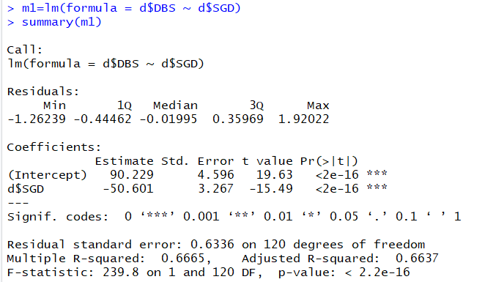
Regression: model=lm(dt$DBS ~ dt$SGD) summary(model)
P-value is very low => SGD is a significant predictor of DBS Share Price or can refer to the star
F-statistic P-value is very low => DBS = -50.601*SGD+90.229 is significant

Slide 45
Activity : What to Predict DBS Share Price base on the formula generated?
DBS = -50.601*SGD+90.229
Machine Learning Process:
After 112 set of data training: We have the coefficient of -50.601 and 90.229.
Testing:
When SGD = 1.38925, what is the error?
When SGD = 1.38707, what is the error?
When SGD = 1.38324, what is the error?
19.93122506 | -0.51877494
20.04153512 | -0.558464884
20.23533673 | -0.214663273

Slide 46
What does the formula means?
DBS = -50.601*SGD+90.229
When Singapore appreciate by 100 basis point, example 1.3800 to 1.3700, then DBS price appreciate by 50.601 * 0.01 = $0.5 (50cents).
By able to predict DBS share price accurately, there is chance that you can buy at lower price if you predict DBS price will appreciate.

Slide 47
Error
pred = predict(model, newdata=dt)
err = dt$DBS - pred
rmse=(mean(err^2)^0.5)
print(rmse)
From F-test, Polynomial is more significant than Linear
How about error? Let us take look at RMSE.
5 types of error:
Error
Square Error
Sum of Square Error
Mean Square Error
Root Mean Square Error

Slide 48
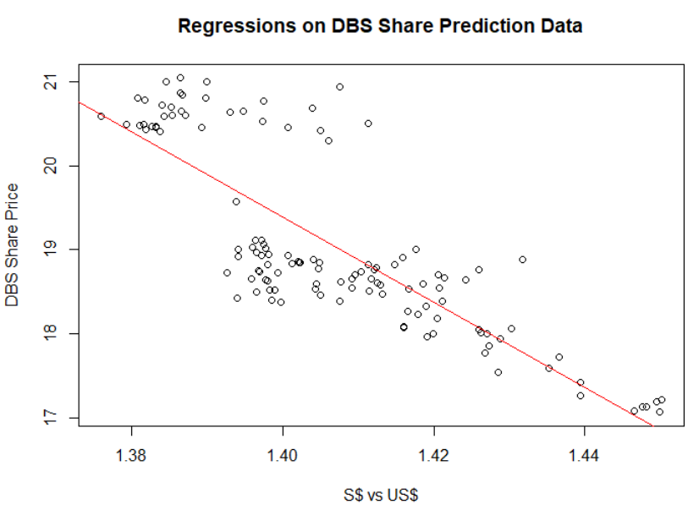
Plot Graph
plot(dt$SGD, dt$DBS, main="Regression Model", xlab = "SGD", ylab="DBS")
abline(model)
What is your conclusion on DBS Price vs Sing$?
Sing$ Strengthen, DBS price goes up
Notes:
Students are expected to look at the difference between the predicted line vs the scattered plot and find other pattern

Slide 49
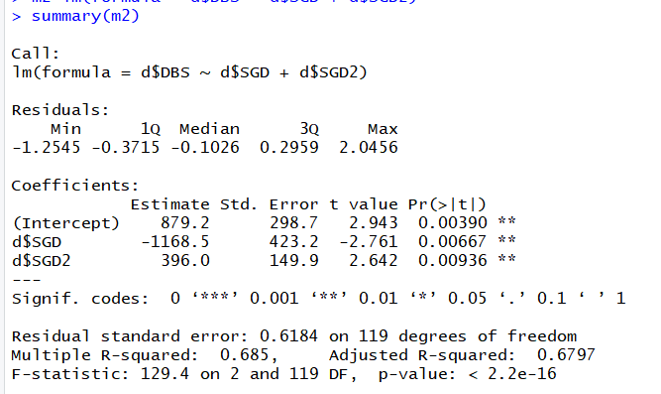
Non-Linear Model
dt$SGD2 = dt$SGD^2
model=lm(dt$DBS ~ dt$SGD + dt$SGD2)
summary(model)
Adjusted R2 for LM

Slide 50
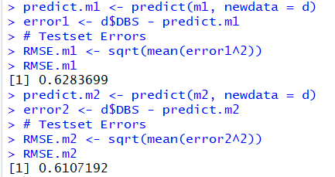
pred = predict(model, newdata = dt)
err=dt$DBS - pred
rmse = (mean(err^2)^0.5)
print(rmse)
Predict is the build in function in R, both data must be in same dimension
Notes:
M2 is better because the RMSE is lower than M1. Significant and Error are related.

Slide 51
Use Python
import pandas as pd
df = pd.read_csv("DBS_SingDollar.csv")
print(df)
X = df.loc[:,["SGD"]]
Y = df.loc[:,['DBS']]
print(X)
from sklearn import linear_model
model = linear_model.LinearRegression()
model.fit(X,Y)
pred = model.predict(X)
from sklearn.metrics import mean_squared_error
rmse = mean_squared_error(Y,pred)**0.5
print(rmse)
#print(rmse/Y.mean(axis=0)*100)
#to add polynomial
df["SGD2"] = df["SGD"] ** 2

Slide 52
Dump parameter to external file and load
from joblib import dump
dump(model, 'Regression.joblib’)
from joblib import load
model = load("Regression.joblib")
X = [[1.4]]
pred = model.predict(X)
print(pred)
import pandas as pd
df = pd.read_csv("C:/Users/Teoh Teik Teo/OneDrive - TSS Global Pte. Ltd/TT Library/AI Model/Data/DBS_SingDollar.csv")
X = df.loc[:, ["SGD"]]
pred = model.predict(X)
print(pred)

Slide 53
Other model
from sklearn import tree
model = tree.DecisionTreeRegressor()
from sklearn.neural_network import MLPClassifier
from sklearn import model = MLPRegressor(solver="lbfgs", hidden_layer_sizes=(3,4)) #hidden layer 1 is 3 neurons and hidden layer 2 is 4 neurons

Slide 54
Flask (Back End)
Check port number netstat
from flask import Flask
app = Flask(__name__)
from flask import request, render_template
import joblib
@app.route("/", methods = ["GET", "POST"])
def i():
if request.method == "POST":
name = request.form.get("name")
print(name)
num = request.form.get("rates")
print(num)
model = joblib.load("DBS Regression Model")
pred = model.predict([[num]])
print(pred)
s = "Predicted DBS Share Price : " + str(pred)
print(s)
return(render_template(“main.html", result = s))
else:
return render_template(“main.html", result ="DBS Share Price Prediction")
#change port number
if __name__ == '__main__':
app.run(host="127.0.0.1", port=int("80"))
# for mac, you may want to try port number 1111
https://stackoverflow.com/questions/60020472/kill-process-on-a-given-port-prior-to-running-a-flask-app
#if run on command line
if __name__=="__main__":
app.run(debug=True)
if __name__=="__main__":
app.run()

Slide 55
Front End HTML
<html>
<body>
<form action = "http://localhost:5000/" method = "post">
<p>Enter Name:</p>
<p><input type = "text" name = "nm"></p>
<p>Enter Sing to US:</p>
<p><input type = "number" step="0.01" name = "num"></p>
<p><input type = "submit" value = "submit"></p>
</form>
{{sentence}}
</body>
</html>

Slide 56
Virtual Environment (Optional)
1. Create virtual environment using cmd
python -m venv v09021930
v09021930\Scripts\activate.bat
2. pip install gunicorn, flask, joblib, sklearn
3. pip freeze > requirements.txt
4. Edit requirements.txt (if needed, usually no)

Slide 57
Example: Bankruptcy Data

Slide 58
Import data
import pandas as pd
df=pd.read_csv("bankruptcy.csv")
X = df.drop(columns = "class")
#feature selection
from sklearn.feature_selection import SelectKBest, f_regression
f = SelectKBest(score_func=f_regression, k=5)
f = model.fit(X, df["class"]).get_support()
X.columns[f]
df = df.loc[:, ['class','Attr3', 'Attr8', 'Attr11', 'Attr16', 'Attr17', 'Attr22', 'Attr26',
'Attr35', 'Attr50', 'Attr51']]
#pd.set_option("display.max_columns", None)
#pd.set_option("display.max_rows", None)

Slide 59
Data Visualization
#https://www.analyticsvidhya.com/blog/2021/07/how-to-perform-data-visualization-with-pandas/
df.describe()
df.boxplot(figsize=(20,10))
df.hist(figsize=(20,20))
#https://seaborn.pydata.org/introduction.html
import seaborn as sns
sns.heatmap(df.corr())
sns.catplot(data=df, x="class", y="Attr3")

Slide 60
pyplotlib
plt.scatter(df['class'],df['Attr3'])
plt.scatter(df['class'], df['Attr8'])
plt.title("Bankruptcy vs Financial Data")
plt.xlabel(“Bankruptcy")
plt.ylabel(“Factors")
plt.legend(["Working Capital","Book Value"])

Slide 61
#check imbalance
df["class"].value_counts()
X = df.drop(columns="class")
Y = df["class"]
from sklearn.model_selection import train_test_split
X_train, X_test, Y_train, Y_test = train_test_split(X, Y, random_state=123)
from imblearn.over_sampling import SMOTE
Y_train.value_counts()
model = SMOTE()
X_train, Y_train =model.fit_resample(X_train, Y_train)

Slide 62
Classifier
from sklearn.metrics import confusion_matrix
from sklearn import linear_model
model = linear_model.LogisticRegression()
model.fit(X_train,Y_train)
pred = model.predict(X_test)
cm = confusion_matrix(Y_test,pred)
print("accuracy", (cm[0,0]+cm[1,1])/(sum(sum(cm))))
from sklearn import tree
model = tree.DecisionTreeClassifier(random_state=123)
model.fit(X_train,Y_train)
pred = model.predict(X_test)
cm = confusion_matrix(Y_test,pred)
print("accuracy", (cm[0,0]+cm[1,1])/(sum(sum(cm))))

Slide 63
Classifier
from sklearn import ensemble
model = ensemble.RandomForestClassifier(random_state=123)
model.fit(X_train,Y_train)
pred = model.predict(X_test)
cm = confusion_matrix(Y_test,pred)
print("accuracy", (cm[0,0]+cm[1,1])/(sum(sum(cm))))
from sklearn import ensemble
model = ensemble.GradientBoostingClassifier(random_state=123)
model.fit(X_train,Y_train)
pred = model.predict(X_test)
cm = confusion_matrix(Y_test,pred)
print("accuracy", (cm[0,0]+cm[1,1])/(sum(sum(cm))))
from sklearn import neural_network
model = neural_network.MLPClassifier(max_iter=500)
model.fit(X_train,Y_train)
pred = model.predict(X_test)
cm = confusion_matrix(Y_test,pred)
print("accuracy", (cm[0,0]+cm[1,1])/(sum(sum(cm))))

Slide 64
Classifier Optimization
X_train1, X_validate, Y_train1, Y_validate = train_test_split(X_train,Y_train)
for i in range(10):
print(i)
model = DecisionTreeClassifier(max_depth = i+1)
model.fit(X_train1, Y_train1)
pred = model.predict(X_validate)
cm = confusion_matrix(Y_validate, pred)
accuracy = (cm[0,0] + cm[1,1])/sum(sum(cm))
print(accuracy)

Slide 65
Save model and load model
# save the model to disk
Import joblib
joblib.dump(model, 'model name')
# load the model from disk and predict from existing to validate the load
model = joblib.load('model name’)
Print(model.predict([[data]]))

Slide 66
Example: Treynor Ratio

Slide 67
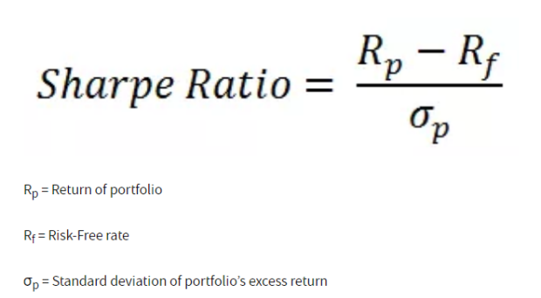
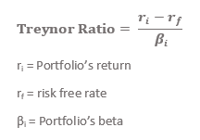
Treynor

Slide 68
Select columns
import pandas as pd
df = pd.read_csv("Treynor.csv")
df.isnull().any()
#pd.set_option('display.max_columns', 100)
#pd.set_option('display.max_rows', 20)
#data not clean, hence use corr
c = df.corr()
c = c["fund_treynor_ratio_5years"]
print(c[c>0.2].sort_values())
#print(df.isnull().sum().sort_values())
df = df.loc[:,["investment_type", "fund_return_5years", "price_earnings_ratio", 'sector_communication_services', "price_book_ratio", "fund_treynor_ratio_5years"]]
df["fund_return_5years"].isnull().sum()

Slide 69
Remove null and not a number
#remove na
df=df.dropna()
#remove not a number
for i in df.columns:
df1 = pd.to_numeric(df[i], errors='coerce')
df=df[df1.notnull()] #make it to null then remove null
print(df)

Slide 70
Categorical Input
df["investment_type"].value_counts()
dummy = pd.get_dummies(df["investment_type"])
df = df.merge(dummy, left_index=True, right_index=True)
df = df.drop(columns="investment_type")

Slide 71
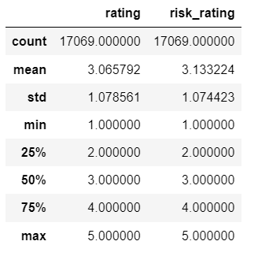
describe
df.describe()

Slide 72
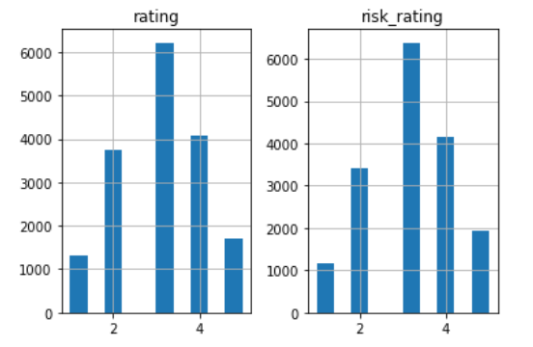
Histogram & Boxplot
df.hist(figsize=(10,10))
df.boxplot(figsize=(20,10))
#optional
import matplotlib.pyplot as plt
plt.boxplot(df)
#https://www.machinelearningplus.com/plots/top-50-matplotlib-visualizations-the-master-plots-python/

Slide 73
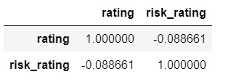
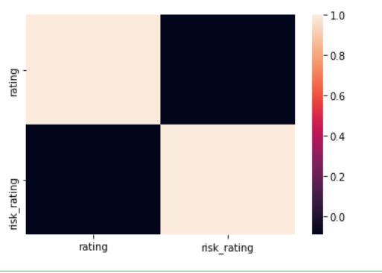
Correlation – check co-linearity, the relationship between the independent variable
import seaborn as sns
sns.heatmap(df.corr())
sns.catplot(data=df,x="investment_type", y="price_book_ratio", kind="bar")
#https://medium.com/geekculture/8-best-seaborn-visualizations-20143a4b3b2f

Slide 74
pyplot
from matplotlib import pyplot as plt
plt.scatter(df.fund_return_5years, df.price_earnings_ratio)
plt.scatter(df.fund_return_5years, df.price_book_ratio)
plt.xlabel(“Fund")
plt.ylabel("Relative")
plt.title("Fund vs Relative")
plt.legend(["price_earnings_ratio", "price_book_ratio"])
plt.show()

Slide 75
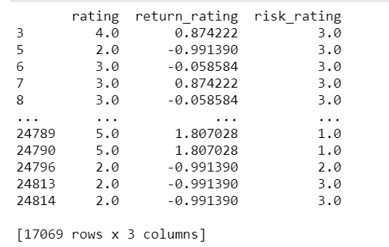
Normalization
pd.set_option('display.max_rows', 10)
for i in X.columns:
X[i]=stats.zscore(X[i].astype(np.float))
print(X)
from scipy import stats
X["sector_communication_services"] = stats.zscore(X["sector_communication_services"])

Slide 76
Split X and Y
X = df.drop(columns= " fund_treynor_ratio_5years ")
Y = df[" fund_treynor_ratio_5years "]

Slide 77
Train Test Split
#split train test
from sklearn.model_selection import train_test_split
X_train, X_test, Y_train, Y_test = train_test_split(X, Y, random_state=123)

Slide 78
Regressor
from sklearn.metrics import mean_squared_error
from sklearn import linear_model
model = linear_model.LinearRegression()
model.fit(X_train, Y_train)
pred = model.predict(X_test)
print("rmse is : ", mean_squared_error(Y_test, pred))
from sklearn import tree
model = tree.DecisionTreeRegressor(random_state=123)
model.fit(X_train, Y_train)
pred = model.predict(X_test)
print("rmse is : ", mean_squared_error(Y_test, pred))

Slide 79
Regressor
from sklearn import ensemble
model = ensemble.RandomForestRegressor(random_state=123)
model.fit(X_train, Y_train)
pred = model.predict(X_test)
print("rmse is : ", mean_squared_error(Y_test, pred))
model = ensemble.GradientBoostingRegressor(random_state=123)
model.fit(X_train, Y_train)
pred = model.predict(X_test)
print("rmse is : ", mean_squared_error(Y_test, pred))
from sklearn import neural_network
model = neural_network.MLPRegressor(max_iter=500)
model.fit(X_train, Y_train)
pred = model.predict(X_test)
print("rmse is : ", mean_squared_error(Y_test, pred))

Slide 80
Regressor Optimization (max_depth)
for i in range(20):
print(i)
model = DecisionTreeRegressor(max_depth= i+2)
model.fit(X_train1, Y_train1)
pred = model.predict(X_validate)
rmse = mean_squared_error(Y_validate, pred) ** 0.5
print(rmse)

Slide 81
Save model and load model
# save the model to disk
Import joblib
joblib.dump(model, 'model name')
# load the model from disk and predict from existing to validate the load
model = joblib.load('model name’)
Print(model.predict([[data]]))

Slide 82
Extra: For regression only: VIF, QQ, ANOVA

Slide 83
Optional : Check Collinearity
#vif to check collinearity
#1 = not correlated.
#Between 1 and 5 = moderately correlated.
#Greater than 5 = highly correlated.
from statsmodels.stats.outliers_influence import variance_inflation_factor
vif_data = pd.DataFrame()
vif_data["feature"] = X.columns
vif_data["VIF"] = [variance_inflation_factor(X.values, i) for i in range(len(X.columns))]
print(vif_data)

Slide 84
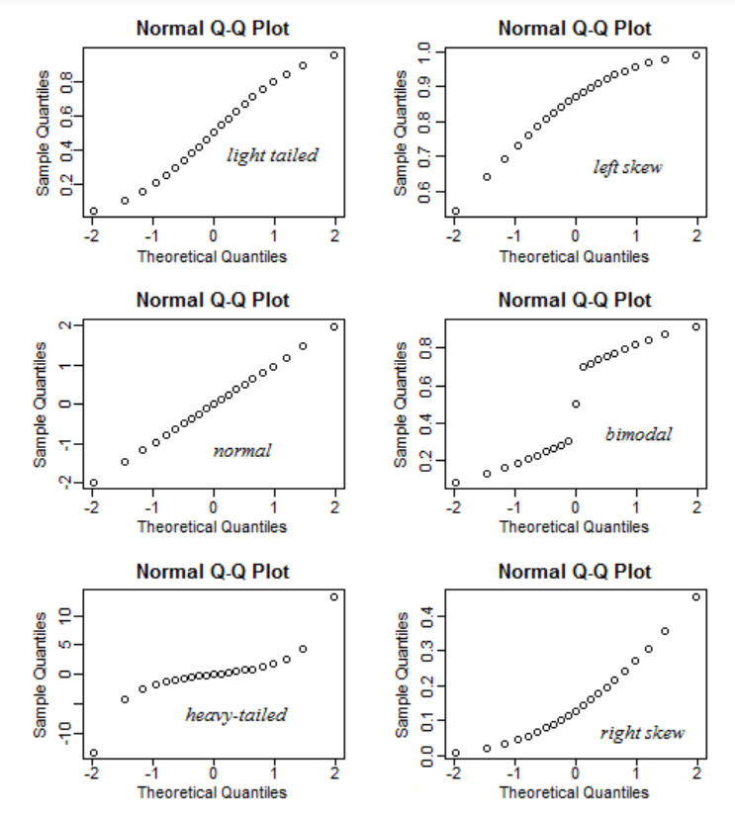
Optional: QQ plot - check heteroskedasticity – residual must be normally distributed
import statsmodels.api as sm
from matplotlib import pyplot as plt
mod_fit = sm.OLS(Y,X).fit()
res = mod_fit.resid # residuals
fig = sm.qqplot(res)
plt.show()

Slide 85
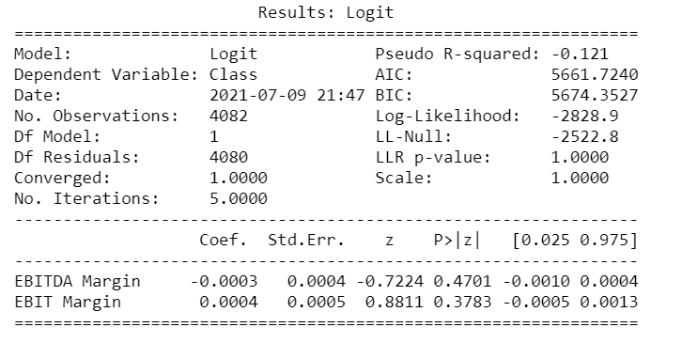
Optional: Anova
from statsmodels.formula.api import ols
from statsmodels.stats.anova import anova_lm
model = ols("Y ~ X", df).fit()
print(model.summary())
anova_results = anova_lm(model)
print('\nANOVA results')
print(anova_results)

Slide 86
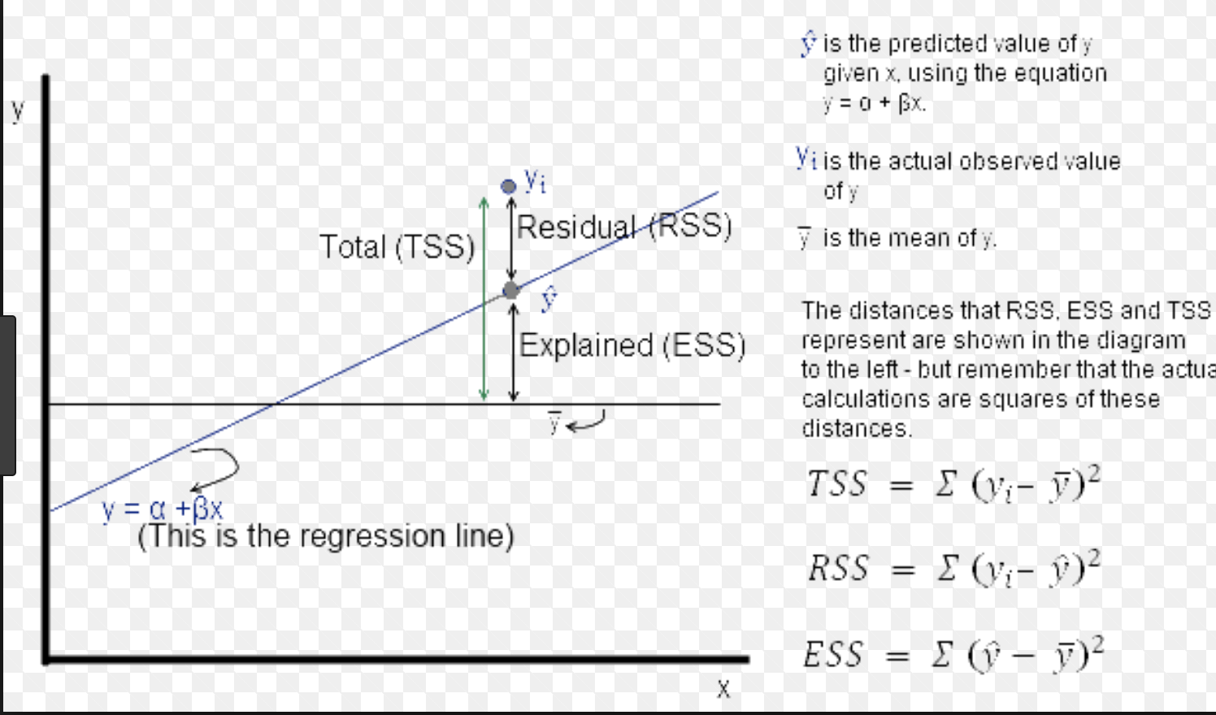
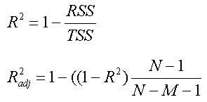
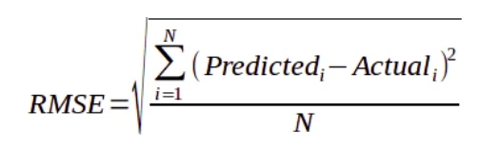
AIC Rsq RMSE
AIC = 2k + n ln(RSS)
RMSE no K
AIC reduce the weight of error but increase the weight of # of independent variable
Rsq using TSS, like ratio style, therefore max is 1
RSS

Slide 87
Other Considerations
Multicollinearity – Relationship Between Variable
Time Series – Correlation between the rows
Notes:
Teach later in the class

Slide 88
What have you learnt?
Regression as Prediction
Types of Regression
Other consideration

Slide 89
Reading Material (Optional)
Shwartz Pg 124 to 130 https://www.dropbox.com/s/ed9s6zyrtjgc7dk/Shwartz.pdf?dl=0
Video
https://www.youtube.com/watch?v=WWqE7YHR4Jc&t=440s
https://www.youtube.com/watch?v=aq8VU5KLmkY
Homework (optional) 25 Questions
https://blog.uwgb.edu/bansalg/statistics-data-analytics/linear-regression/

Slide 90
Thank you

